Slide 1


Tableau - Functions

Slide 2
AVG
CASE
The AVG function returns the average value for an expression. It is calculated as the sum of all of the numbers for the expression divided by the count of the number of records in that expression. For example, if you have a set containing (24, 30, 15, 5, 18) the average of those five numbers will be: (24 +30+15+5+16)/5 =15.
The CASE function is provided with an expression/data field, which can be defined as the CASE statement source. The data values located within this source field are compared against a sequence of values determined by the user within the CASE statement. If any of the values within the expression match the user-determined values, then a return expression is created. If no match is found, then a default return expression is used. These return expressions must be coded; otherwise, NULL values are returned. CASE functions are only applicable to string expressions.
CASE expression WHEN value1 THEN return1 WHEN value2 THEN return2 ...... ELSE default return END
Basic
CASE [Month] WHEN 1 THEN "January"
WHEN 2 THEN "February"
WHEN 3 THEN "March"
WHEN 4 THEN "April"
ELSE "Not required"
END
This example will look at the month field—containing integers—and return the corresponding month strings defined.
Basic
AVG([Discount])
The result is the average discount for whatever level of details is exposed in the view
Intermediate
AVG(DATEDIFF('day',[Order Date],[Ship Date]))
This will calculate the number of days between the order date and the ship date, and then provide the average for the level of detail displayed in the view.
Advanced
AVG(IF(DATEDIFF('day',[Order Date],[Ship Date])<=[Time to Ship Goal]) THEN 1 ELSE 0 END)
This calculation compares the number of days it takes to ship an item to a parameter (variable) [Time to Ship Goal]. If the time is less than or equal to the parameter, a 1 is returned. If it’s greater than the parameter a 0 is returned. Then, the average of those values is calculated and could be used to derive the percentage of items that shipped within the time specified by the selected parameter value.

Slide 3
CASE
COUNT
Intermediate
STR (DAY([Order Date])) + " " + (CASE [Month]
WHEN 1 THEN "January"
WHEN 2 THEN "February"
WHEN 3 THEN "March"
WHEN 4 THEN "April"
WHEN 5 THEN "May"
WHEN 6 THEN "June"
WHEN 7 THEN "July"
WHEN 8 THEN "August"
WHEN 9 THEN "September"
WHEN 10 THEN "October"
WHEN 11 THEN "November"
WHEN 12 THEN "December"
ELSE "Data Error"
END) + " " + STR(YEAR([Order Date]))
The function examples above highlight the flexible nature that the CASE statement allows. It allows for multiple descriptive return expressions to group the results returned.
The CONTAINS function gives the user the ability to search for any sequence of characters (SUBSTRING) that may be present within a searchable string. The CONTAINS function returns a boolean value of True or False.
Basic
CONTAINS([City],"New")
This function returns a True value for all the Customer Cities held within the data that has New within its name and in that sequence of characters. The case of the letters within the substring is irrelevant and does not affect the outcome. new, New, and nEw are all valid and will return the same result.
This function returns the count of the items in a group. NULL values are not counted.
Basic
COUNT([Ship Date])
The formula returns the count of records that have a ship date value. Records missing a ship date entry will be NULL and the record will not be counted.
Intermediate
COUNT([Ship Date]) / COUNT(1)
This example divides the number of records that have a ship count by the count of all records. Using a constant value as the expression will mean it is never NULL, so COUNT(1) is equal to the count of records. Every Department has 100 percent of the items shipped, so that means there were no NULL values in Ship Date.
Advanced
COUNT(IF([Discount]=0 THEN NULL ELSE 1))/COUNT(1)
This formula will look at the discount field and if the value is 0 it will not be counted. The resulting count is then divided by the total number of rows to derive the percentage of items that have a discount.
CONTAINS

Slide 4
COUNTD
DATE
Count distinct returns the number of distinct items in a group. NULL values are not counted. Each unique value is counted only once.
Basic
COUNTD([Customer Name])
This formula returns the count of unique customer names. Any record where customer name is NULL will not be counted. It will count each unique name only once regardless of the number of records including the name. Note: If your data source is Excel, Access, or a text file, you must extract the data for this function to be available.
Intermediate
COUNTD([City]+[State])
This formula combines the city and state fields to create a new field in order to count the number of unique city-state combinations. Note that the + sign concatenates the city and state fields together.
Advanced
COUNTD(IF([Country]=[Country Parameter]) THEN [Customer Name] ELSE NULL END)
The formula counts the unique customer instance for a selected country. The parameter (variable) permits the user to select the country to count customer names. Any other country is viewed as NULL so it will not be counted.
The DATE function converts a given input into a date. This is similar to the DATETIME function, but doesn’t include time. This is especially useful when you have string dates in your data source or are building your own dates using other data sources.
Basic
DATE("March 15, 2013")
The preceding example converts the string to a date value of March 15, 2013.
Intermediate
DATE([DateString])
The preceding formula returns a date if [DateString] is a valid date type; otherwise, it will return NULL.
Advanced
DATE(STR([Year]) + '/'+ STR([Month]) + '/' + STR([Day]))
The previous formula returns a date constructed from various components in the data source. This is especially useful when the data source has date elements in it, but no true date dimension. This allows you to create that date dimension so you can use Tableau’s auto-generated date hierarchy in views

Slide 5
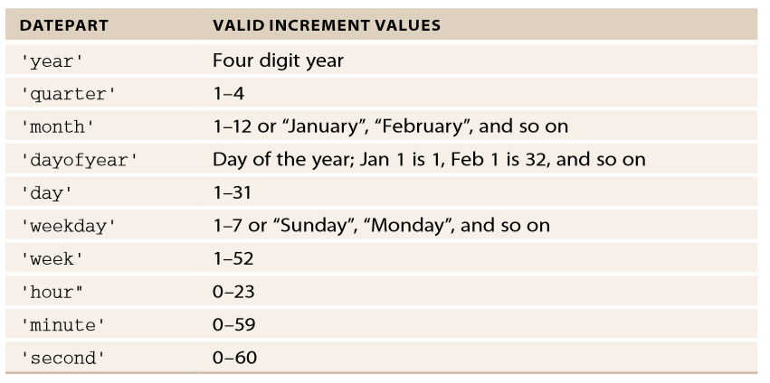
DATEADD
DATEADD
The DATEADD function adds a specified time period to a given date. This function is useful when you want to calculate new dates off of another date in your data set, to create reference lines in time series analysis, or to create dimensions to use for filtering.
DATEADD(DatePart, Increment, Date)
The DatePart specifies the type of time period that is being added. It is always specified in single quotes and lower case (for example: ‘day’). Increment specifies the exact amount of time to add. Table A-3 below displays value data parts that can be used with date functions to specify granularity of the date and/or time contained in the result.
Date is the actual date used for the addition. This value can be a constant value, field, parameter, or another function that returns a date.
Basic
DATEADD('day', 3, Date)
The preceding formula returns a date three days after the given Date. In this case, if Date was equal to June 3, 2012 the function would return June 6, 2012.
Intermediate
DATEADD('day', -30, TODAY())
The preceding formula returns a date 30 days before today’s date. If today is March 18, 2013 then this function will return February 16, 2013. This can be very useful in filtering for specific periods (like 30 rolling days) or highlighting a period on a timeline where data may be uncertain.
Advanced
DATEADD('month', -12, WINDOW_MAX(MAX([Date])))
The advanced example formula returns a date that is 12 months before the last date in the defined window (see the WINDOWMAX calculation for more details). It’s common in many businesses for data to be days, weeks, or even months old. This method gives you a date 12 months from the end of the data set, no matter how big (or small) the gap is between the end of the data set and the current date.

Slide 6
DATEDIFF
DATEDIFF
The DATEDIFF function calculates the time between two given dates. This is useful for creating additional metrics or dimensions for your analysis. It returns an integer value of a specified unit of time.
DATEDIFF(DatePart, Date1, Date2)
DatePart specifies the type of time period that is being returned. It is always specified in single quotes and lower case (for example: ‘day’). See the DATEADD entry for valid DatePart values. Date1 and Date2 are the actual dates used for subtraction. The values can be constants, fields, parameters, other functions that return dates, or combinations of any of these.
Basic
DATEDIFF('day', #June 3, 2012#, #June 5, 2012#)
The preceding formula uses the DATEDIFF function to calculate the difference In Days between the two date literal values in the formula—which in this example results in the answer of 2 days. Keep in mind you can use date fields in your data set to specify flexible date values as well.
Intermediate
DATEDIFF('day',[InvoiceDate], TODAY())
The preceding formula is returning the number of days between the two dates. This is a common setup for aging reports. The example derives the current age of the invoice in days. If today is March 18, 2013 and we have an invoice with an [InvoiceDate] of January 10, 2013, the function would return 67 (days). This can be very useful, especially when combined with Bins.
Advanced
CASE [Parameter].[Date Unit]
WHEN 'Day' THEN DATEDIFF('day',[OrderDate],[ShipDate])
WHEN 'Week' THEN DATEDIFF('week',[OrderDate],[ShipDate])
END
The preceding formula returns an integer, either the number of days or weeks between the two dates. In this example you’re using a parameter, [Date Unit]. This parameter is a string type that allows the user to input the time period they want returned in the result (days or weeks). This allows the user to determine the best way to express the answer.
The IF statement is a basic version of the IIF statement; however, it uses the same logical processing. It has less logic that can be used in simple calculations.
IF test THEN value END / IF test THEN value ELSE else END
Basic
IF([Order Quantity] > 10 THEN "Bulk Buy" ELSE "Non Bulk" END
This example provides simple segmenting of the order quantities greater than ten units to be named Bulk Buys, while all lesser order quantities are classified as Non Bulk. Adding more ELSEIF clauses provides a means for adding more logical criteria.
IF test1 THEN value1 ELSEIF test2 THEN value2 ELSE else END
Intermediate
IF [Ship Mode] = "Regular Air"
THEN "Customs Required"
ELSEIF [Ship Mode] = "Express Air"
THEN "Express Customs"
ELSE "No Customs"
END
This formula evaluates the [Ship Mode] field. If it contains “Regular Air” then the answer returned will be “Customs Required.” If it contains “Express Air,” the answer returned will be “Express Customs.” Any other value in the field will return “No Customs.
IF

Slide 7
IFNULL
IIF
The IFNULL statement is a simple reference function against a field. It contains two expressions. The first expression is a testing expression, and the second is the override expression. If the first expression is FALSE, then it returns the override expression as the result. If the first expression is TRUE then it retains that value.
IFNULL(expresson1,expression2)
This formula will evaluate expression1. If expression1 is FALSE, then expression2 is returned. If expression1 is TRUE, then it returns the expression1 value.
Basic
IFNULL([Customer],"Unidentified")
This example determines if the Customer record has a NULL value. If the customer field does have a NULL value then it will return the string Unidentified; otherwise, the customer name will remain.
The IIF function uses similar logic to the CASE statement; however, its arguments and return values are not as flexible. The IIF statement contains a TEST argument, followed by a THEN statement, and an ELSE statement. The test argument is first calculated; if the result is a TRUE Boolean value then it returns the THEN statement as an answer. If the result of the argument is FALSE then it returns the ELSE statement as an answer. An additional UNKNOWN value can be added to the end of an IIF statement should the TEST argument not return either a TRUE or FALSE value.
IIF(test,then,else) or IIF(test, then, else,[unknown])
Basic
IIF(1<2,True,False)
The expression will return True.
Intermediate
IIF([Time to Ship]>12,"Within SLA", "Outside SLA" )
If the time to ship is greater than 12, then the function returns Within SLA. Otherwise, the function returns Outside SLA.
Advanced
IIF([Order Date]< Today()-14 and [Ship Mode] = "N" ,
"High Priority",IIF([Order Date]<Today()-4 and
[Ship Mode] = "N","Medium Priority","Low Priority"))
This more complex example checks first for order dates that are 14 days before today’s date and with a ship mode of N, returning high priority in this case. More recent orders that are within four days of today’s date are classified as Medium priority if ship mode is N. Otherwise, they are classed as low priority orders. Nested IIF statements can be used to embed intricate logic in comparisons.

Slide 8
ISDATE
LEN
The function ISDATE checks to see if a text is a valid date. The resulting output is a Boolean value. If the date string is valid, it will return TRUE; otherwise, an invalid date string returns a FALSE value.
ISDATE(Text)
Text is the value you want to test.
Basic
ISDATE("This is not a date")
The preceding formula returns FALSE.
Intermediate
ISDATE("01 January 2013")=TRUE ISDATE("1st January 2012")=FALSE ISDATE("1/9/2012")=TRUE
The preceding formula returns TRUE values for strings that are appropriately formatted as dates. The FALSE result is due to the 1st not being recognized as a valid date format.
Advanced
ISDATE(STR([Year]) + '/' + STR([Month]) + '/' + STR([Day]))
The preceding formula returns TRUE if the date constructed is valid.
The ISNULL statement is a simple Boolean function. It only requires one expression and only returns the Boolean value of TRUE or FALSE.
ISNULL(expression)
Basic
ISNULL([Customer])
The ISNULL example above will return a TRUE value if a customer name exists or a FALSE value if the Customer field is NULL.
LEN is a function that returns a number value for the total length of a string. Note LEN counts spaces between string characters to contribute to the LEN total value.
LEN(String)
Basic
LEN("Bob Hope")
The value returned for the above calculation is (8), (3) for Bob, (1) for the space, and (4) for Hope.
Advanced
The Advanced FIND example that was provided previously uses the LEN statement to help complete the calculation.
RIGHT([Customer],LEN([Customer])-FIND([Customer],"'",4)+2)
This formula calculates the length of the field [Customer], subtract the index value for the location of any apostrophes within [Customer], and take the RIGHT most number of characters. The number of characters is the result of the simple subtraction that is taking place.
ISNULL

Slide 9
MAX
MEDIAN
The MAX function is normally reserved for numbers; however, this function can also be used on strings within Tableau. When MAX is applied to strings, the MAX value returns the string that is highest within the data’s sort sequence for that particular string.
MAX(a,b)
Basic
MAX("Maureen","William")
On the assumption that the name field that you are considering above is sorted in ascending alphabetical order within the database, the function examples’ output would be "William". It considers the first name in alphabetical order to be the lowest and the last name to be the highest, and thus "William" is returned. If any of the strings used in the comparison logic have a value of NULL, then NULL will be the resulting output.
Intermediate
MAX([Sales])
This example returns the maximum value across all the rows in the database.
MAX([Sales],[Profit])
This example returns the maximum value between sales and profit for every row in the database.
The MAX function can also be used as String Function or Date Function, whereby expression1 and expression2 are string or date data types respectively.
Advanced
MAX(ABS([Sales]-[Sales est]))
This formula returns the difference between the estimated sales and actual sales. In this example the largest differences (positive or negative) would be derived and displayed for any dimension expressed in the view.
This function returns the median of a single expression. MEDIAN can be used with numeric fields only. NULL values are ignored. If your data source is Excel, Access, or a text file—this function will not be available unless the data source is extracted.
Basic
MEDIAN([Discount])
This formula will return the MEDIAN value of discount for whatever dimension, or level of detail in view.
Intermediate
MEDIAN(DATEDIFF('day',[Order Date],[Ship Date])
This formula returns the MEDIAN difference between the order date and ship date, and expresses the result in days for any dimension displayed in the view.

Slide 10
STDEV
STR
This function returns the statistical Standard Deviation of the expression using a sample of the population (compared to STDEVP, which uses the entire population to calculate the standard deviation).
Basic
STDEV([Sales])
This Formula will return the standard deviation of sales. One possible use would be to use the result for reference lines on a time series chart.
Intermediate
AVG([Sales])+STDEV([Sales])
This example shows how you can combine the Standard Deviation calculation with the Average calculation to find the value for the first Standard Deviation.
Advanced
AVG([Sales])+(([Number of deviations])*STDEV([Sales]))
This formula uses a parameter to change the number of standard deviations from the mean value you wish to calculate. The number of deviations could be limited to the values (1, 2, and 3).
Returns a string for a given expression.
Basic
STR(5.0)
The preceding formula changes a number into a string value of 5.0.
Intermediate
"Total Products = " + STR([Qty])
The preceding formula returns a string. In this example a custom label is being created using a number field [Qty]. If [Qty] has a value of 10, then this function returns Total Products = 10.
Advanced
STR([StartDate]) ' to ' + STR([EndDate])
The preceding formula returns a string describing the period (start to end). This is useful when you’d like to have an annotation, Tooltip, or other label that describes the period of analysis in a custom formatted way. If [StartDate]) is equal to January 1, 2013 and [EndDate] is equal to March 1, 2013 then the function will return January 2013 to March 2013.

Slide 11
TODAY
ZN
The TODAY function returns the current date. This is similar to NOW() but does not include the time component.
Basic
TODAY( )
The preceding function works as follows: If today’s date is March 12, 2013 at 3:04pm the function will return the date March 12, 2013.
Intermediate
DATEADD('day', -30, TODAY())
The preceding formula returns a date 30 days before today’s date. If today is March 18, 2013 then this function will return February 16, 2013. This can be very useful in filtering for specific periods (like 30 rolling days) or highlighting a period on a timeline where data may be uncertain.
ZN (expression)
Expression = any given number. The ZN (zero NULL) function is used to return zero values where NULL values exist in the view. If the value is not NULL, then the function returns the expression; otherwise, it returns zero. Use ZN to avert NULL results.
Basic
ZN([Profit])
This function will look at all values for Profit that exist in the view and returns Profit value if it is not NULL; otherwise, it will return zero.
Intermediate
ZN(SUM([Profit]))-LOOKUP(ZN(SUM([Profit])),-1)
This function returns the difference in profit from the current row to the value in the relative offset of this row; in this case the target row is the previous row. The ZN function is applied twice. In the first calculation the ZN function is applied to return zero if the value is NULL. Then ZN is included in the LOOKUP expression to avoid returning NULL values there as well.

Slide 12
Tableau – Context Filters

Slide 13
Tableau – Which graph is right for you?

Slide 14
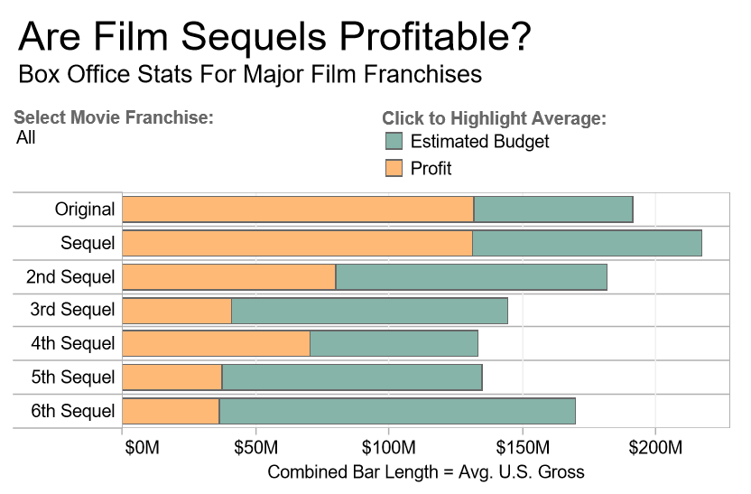
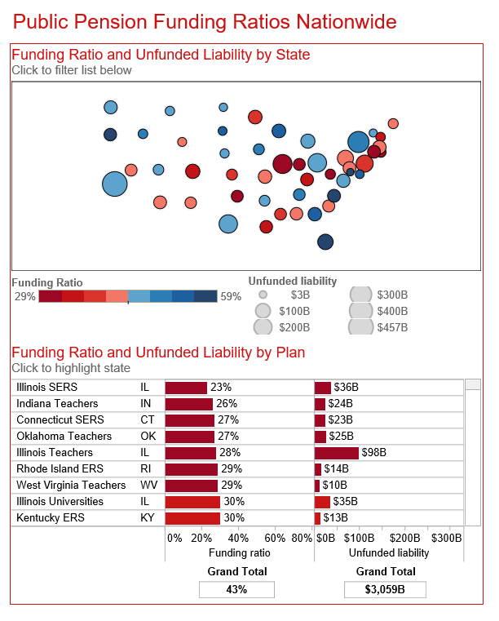
Bar Chart
Bar charts are one of the most common ways to visualize data. Why?
It’s quick to compare information, revealing highs and lows at a glance. Bar charts are especially effective when you have numerical data that splits nicely into different categories so you can quickly see trends within your data.
When to use bar charts:
Comparing data across categories. Examples: Volume of shirts in different sizes, website traffic by origination site, percent of spending by department.
Also consider:
Include multiple bar charts on a dashboard. Helps the viewer quickly compare related information instead of flipping through a bunch of spreadsheets or slides to answer a question.
Add colour to bars for more impact. Showing revenue performance with bars is informative, but overlaying colour to reveal profitability provides immediate insight.
Use stacked bars or side-by-side bars. Displaying related data on top of or next to each other gives depth to your analysis and addresses multiple questions at once.
Combine bar charts with maps. Set the map to act as a “filter” so when you click on different regions the corresponding bar chart is displayed.
Put bars on both sides of an axis. Plotting both positive and negative data points along a continuous axis is an effective way to spot trends.
Are film sequels profitable? In this example of a bar chart, you quickly get a sense of how profitable sequels are for box office franchises.
Don’t settle for a bar chart that leaves you scrolling to find the answers you seek. By combining a bar chart with a map, this dashboard showing public pension funding ratios in the U.S. provides rich information at a glance. When California is selected, for example, the bar chart filters to show state-specific information.

Slide 15
Tableau is one of the best tools out there for creating really powerful and insightful visuals. We’re using it for analytics that require great data visuals to help us tell the stories we’re trying to tell to our executive management team.

Slide 16
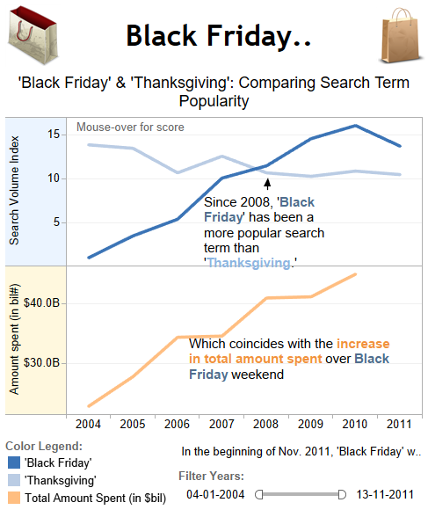
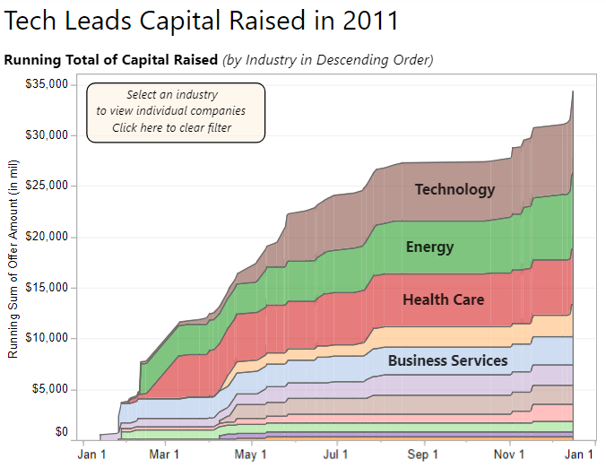
Line Chart
Line charts are right up there with bars and pies as one of the most frequently used chart types. Line charts connect individual numeric data points. The result is a simple, straightforward way to visualize a sequence of values. Their primary use is to display trends over a period of time.
When to use line charts:
Viewing trends in data over time. Examples: stock price change over a five-year period, website page views during a month, revenue growth by quarter.
Also consider:
Combine a line graph with bar charts. A bar chart indicating the volume sold per day of a given stock combined with the line graph of the corresponding stock price can provide visual queues for further investigation.
Shade the area under lines. When you have two or more line charts, fill the space under the respective lines to create an area chart. This informs a viewer about the relative contribution that line contributes to the whole.
These two line charts illuminate the increasing popularity of “Black Friday” as an epic event in the United States
Often when you have two or more sets of data in a line chart it can be helpful to shade the area under the line. In this chart, it’s easy to tell that companies in the technology sector raised more capital than real estate in 2011.

Slide 17
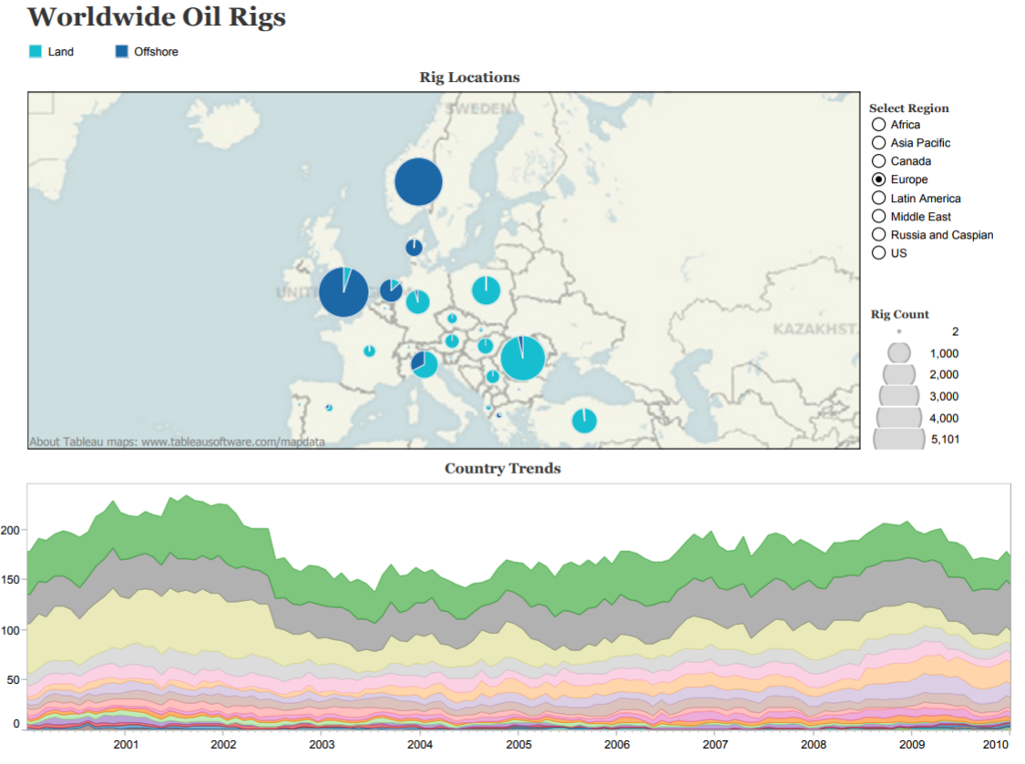
Pie Chart
Pie charts should be used to show relative proportions – or percentages – of information. That’s it. Despite this narrow recommendation for when to use pies, they are made with abandon. As a result, they are the most commonly mis-used chart type. If you are trying to compare data, leave it to bars or stacked bars. Don’t ask your viewer to translate pie wedges into relevant data or compare one pie to another. Key points from your data will be missed and the viewer has to work too hard.
When to use pie charts:
Showing proportions. Examples: percentage of budget spent on different departments, response categories from a survey, breakdown of how Americans spend their leisure time.
Also consider:
Limit pie wedges to six. If you have more than six proportions to communicate, consider a bar chart. It becomes too hard to meaningfully interpret the pie pieces when the number of wedges gets too high.
Overlay pies on maps. Pies can be an interesting way to highlight geographical trends in your data. If you choose to use this technique, use pies with only a couple of wedges to keep it easy to understand.
Pie charts give viewers a fast way to understand proportional data. Using pie charts on this map shows the distribution of oil rigs on land vs. offshore in Europe.

Slide 18
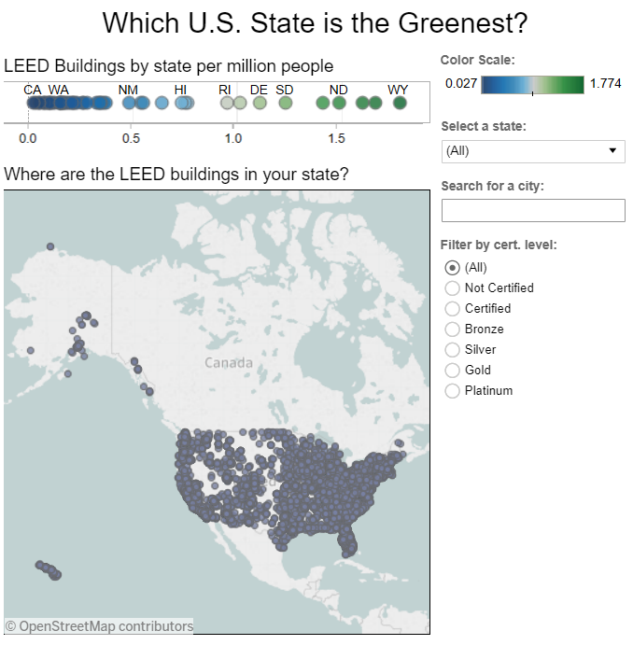
Map
When you have any kind of location data – whether it’s postal codes, state abbreviations, country names, or your own custom geocoding – you’ve got to see your data on a map. You wouldn’t leave home to find a new restaurant without a map (or a GPS anyway), would you? So demand the same informative view from your data.
When to use maps:
Showing geocoded data. Examples: Insurance claims by state, product export destinations by country, car accidents by zip code, custom sales territories.
Also consider:
Use maps as a filter for other types of charts, graphs, and tables. Combine a map with other relevant data then use it as a filter to drill into your data for robust investigation and discussion of data.
Layer bubble charts on top of maps. Bubble charts represent the concentration of data and their varied size is a quick way to understand relative data. By layering bubbles on top of a map it is easy to interpret the geographical impact of different data points quickly.
Maps are a powerful way to visualize data. In this visualization you can zero in on every LEED certified building in the United States based on their street address.

Slide 19
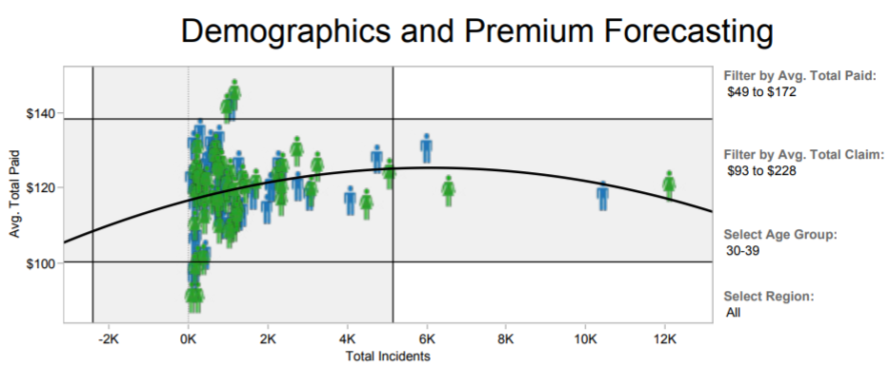
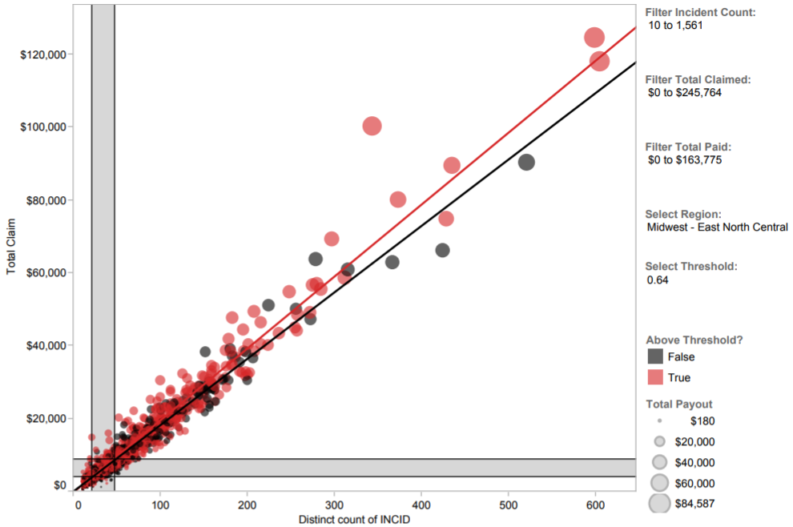
Scatter Plot
Looking to dig a little deeper into some data, but not quite sure how – or if – different pieces of information relate? Scatter plots are an effective way to give you a sense of trends, concentrations and outliers that will direct you to where you want to focus your investigation efforts further.
When to use scatter plots:
Investigating the relationship between different variables. Examples: Male versus female likelihood of having lung cancer at different ages, technology early adopters’ and laggards’ purchase patterns of smart phones, shipping costs of different product categories to different regions.
Also consider:
Add a trend line/line of best fit. By adding a trend line the correlation among your data becomes more clearly defined.
Incorporate filters. By adding filters to your scatter plots, you can drill down into different views and details quickly to identify patterns in your data.
Use informative mark types. The story behind some data can be enhanced with a relevant shape
Who is most expensive to insure?
Use an informative icon or “mark type” such as the female and male icons for additional detail in your scatter plot. Select the graph and filter to see how demographics change insurance premium forecasting for an employer
Can you spot the fraud? Using scatter plots is a quick, effective way to spot outliers that might warrant further investigation. By creating this interactive scatter plot, an insurance investigator can quickly evaluate where they might have fraudulent activity

Slide 20
Visualizing data using colour, shapes, positions on
X and Y axes, bar charts, pie charts, whatever
you use, makes it instantly visible and instantly
significant to the people who are looking at it.

Slide 21
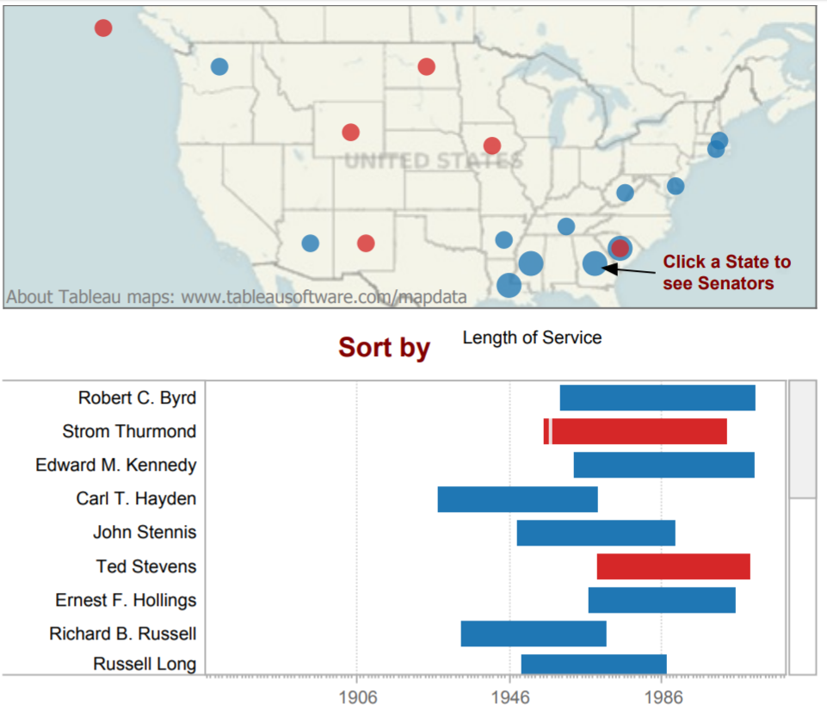
Gantt Chart
Gantt charts excel at illustrating the start and finish dates elements of a project. Hitting deadlines is paramount to a project’s success. Seeing what needs to be accomplished – and by when – is essential to make this happen. This is where a Gantt chart comes in. While most associate Gantt charts with project management, they can be used to understand how other things such as people or machines vary over time. You could use a Gantt, for example, to do resource planning to see how long it took people to hit specific milestones, such as a certification level, and how that was distributed over time.
When to use Gantt charts:
Displaying a project schedule. Examples: illustrating key deliverables, owners, and deadlines.
Showing other things in use over time. Examples: duration of a machine’s use, availability of players on a team.
Also consider:
Adding colour. Changing the colour of the bars within the Gantt chart quickly informs viewers about key aspects of the variable.
Combine maps and other chart types with Gantt charts. Including Gantt charts in a dashboard with other chart types allows filtering and drill down to expand the insight provided.
Who served the longest? With a quick glance, this Gantt chart lets you know which U.S. senator held office the longest and which side of the aisle they represented. Select the visualization and use the drop down menu to see criteria such as party.

Slide 22
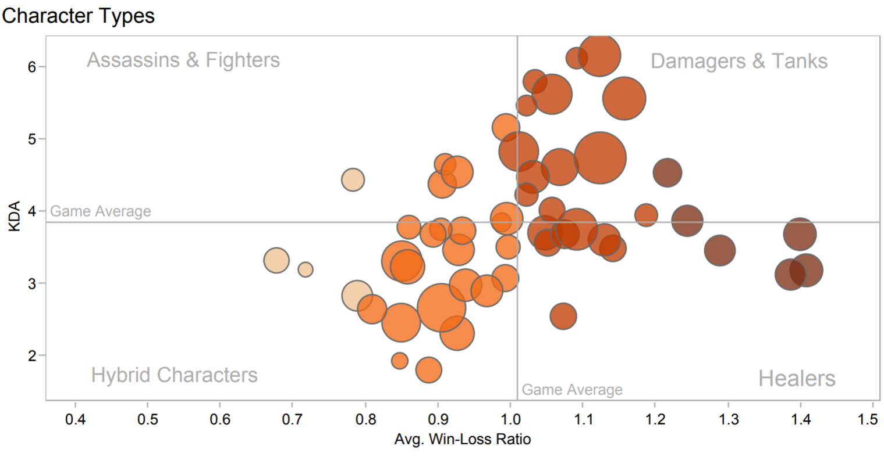
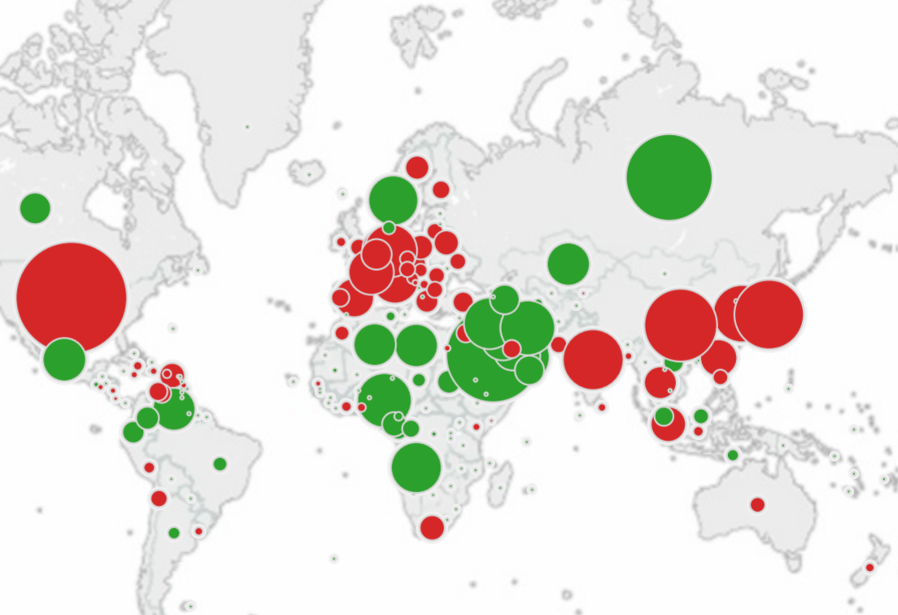
Bubble Chart
Bubbles are not their own type of visualization but instead should be viewed as a technique to accentuate data on scatter plots or maps. Bubbles are not their own type of visualization but instead should be viewed as a technique to accentuate data on scatter plots or maps. People are drawn to using bubbles because the varied size of circles provides meaning about the data.
When to use bubbles:
Showing the concentration of data along two axes. Examples: sales concentration by product and geography, class attendance by department and time of day.
Also consider:
Accentuate data on scatter plots: By varying the size and colour of data points, a scatterplot can be transformed into a rich visualization that answers many questions at once.
Overlay on maps: Bubbles quickly inform a viewer about relative concentration of data. Using these as an overlay on map puts geographically-related data in context quickly and effectively for a viewer.
In this scatter plot accentuated with bubbles, the varied size and colour of circles make it quick to see how the game’s players compare.
It’s easy to tell who buys and sells the most oil with green bubbles for net exporters and red for net importers overlaid on this map.

Slide 23
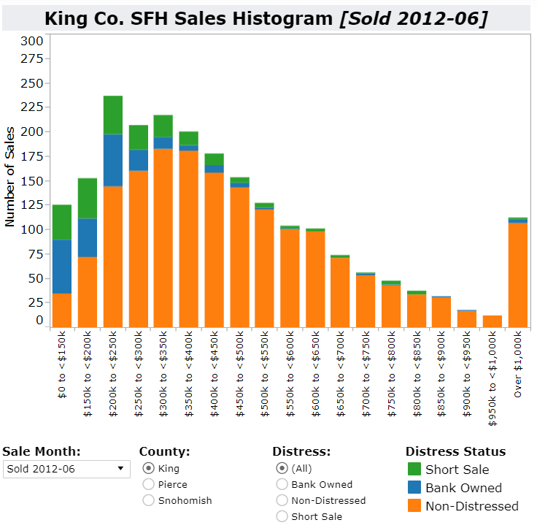
Histogram
Use histograms when you want to see how your data are distributed across groups. Say, for example, that you’ve got 100 pumpkins and you want to know how many weigh 2 pounds or less, 3-5 pounds, 6-10 pounds, etc. By grouping your data into these categories then plotting them with vertical bars along an axis, you will see the distribution of your pumpkins according to weight. And, in the process, you’ve created a histogram. At times you won’t necessarily know which categorization approach makes sense for your data. You can use histograms to try different approaches to make sure you create groups that are balanced in size and relevant for your analysis.
When to use histograms:
Understanding the distribution of your data. Examples: Number of customers by company size, student performance on an exam, frequency of a product defect.
Also consider:
Test different groupings of data. When you are exploring your data and looking for groupings or “bins” that make sense, creating a variety of histograms can help you determine the most useful sets of data.
Add a filter. By offering a way for the viewer to drill down into different categories of data, the histogram becomes a useful tool to explore a lot of data views quickly.
This histogram shows which houses are seeing the most sales in a month.

Slide 24
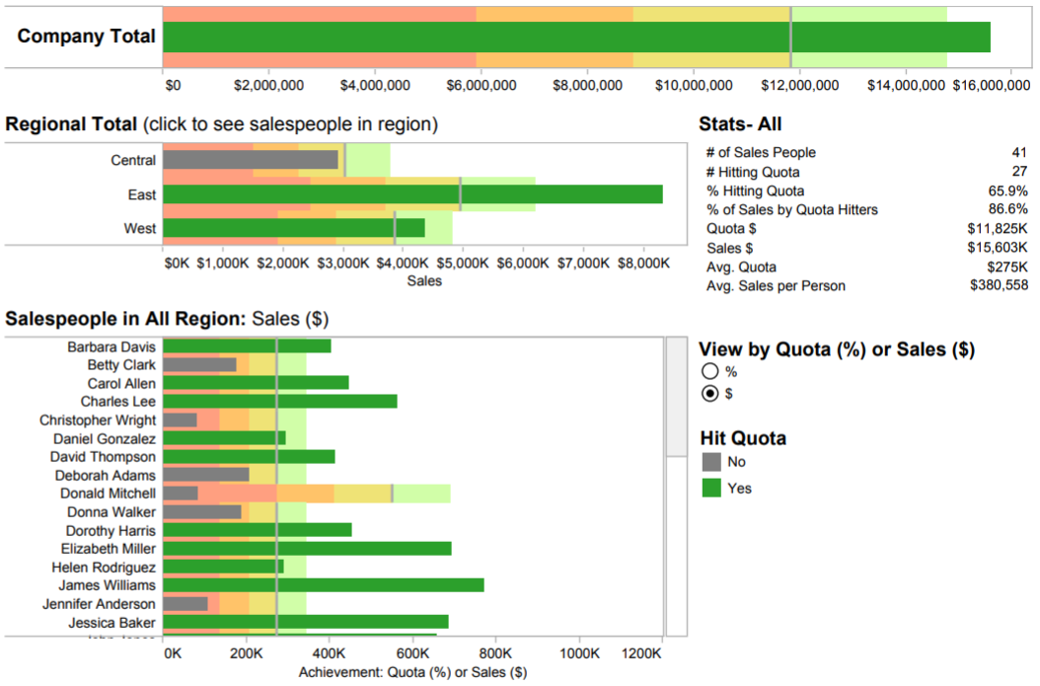
Bullet Graph
When you’ve got a goal and want to track progress against it, bullet charts are for you. At its heart, a bullet graph is a variation of a bar chart. It was designed to replace dashboard gauges, meters and thermometers. Why? Because those images typically don’t display sufficient information and require valuable dashboard real estate. Bullet graphs compare a primary measure (let’s say, year-to-date revenue) to one or more other measures (such as annual revenue target) and presents this in the context of defined performance metrics (sales quota, for example). Looking at a bullet graph tells you instantly how the primary measure is performing against overall goals (such as how close a sales rep is to achieving her annual quota).
When to use bullet graphs:
Evaluating performance of a metric against a goal. Examples: sales quota assessment, actual spending vs. budget, performance spectrum (great/good/poor).
Also consider:
Use colour to illustrate achievement thresholds. Including colour, such as red, yellow, green as a backdrop to the primary measure lets the viewer quickly understand how performance measures against goals.
Add bullets to dashboards for summary insights. Combining bullets with other chart types into a dashboard supports productive discussions about where attention is needed to accomplish objectives
Tracking a sales team’s progression to hitting its quota is a critical element to managing success. In this quota dashboard, a sales manager can quickly select to view her team’s performance by quota percentage or sales amount as well as zero in on regional achievement.

Slide 25
Tableau has many great visualization capabilities. We use a lot of mapping, not only to show the geographical location, but also to do a lot of geocoding and we map relationships with geocoding the distances.

Slide 26
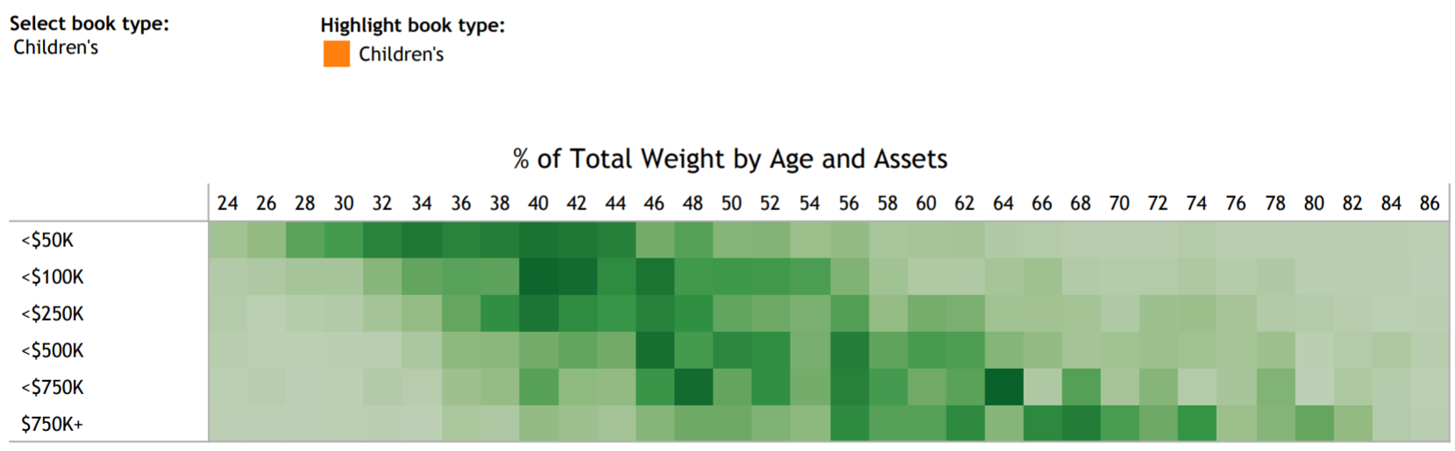
Heat Maps
Heat maps are a great way to compare data across two categories using colour. The effect is to quickly see where the intersection of the categories is strongest and weakest.
When to use heat maps:
Showing the relationship between two factors. Examples: segmentation analysis of target market, product adoption across regions, sales leads by individual rep.
Also consider:
Vary the size of squares. By adding a size variation for your squares, heat maps let you know the concentration of two intersecting factors, but add a third element. For example, a heat map could reveal a survey respondent’s sports activity preference and the frequency with which they attend the event based on colour, and the size of the square could reflect the number of respondents in that category.
Using something other than squares. There are times when other types of marks help convey your data in a more impactful way.
In this market segmentation analysis, the heat map reveals a new campaign idea. High income households of people in their sixties buy children’s books. Perhaps it’s time for a new grandparent-oriented campaign?

Slide 27
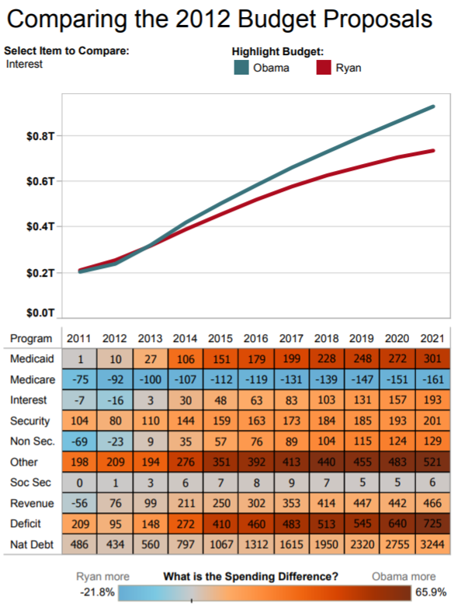
Highlight Tables
Highlight tables take heat maps one step further. In addition to showing how data intersects by using colour, highlight tables add a number on top to provide additional detail.
When to use highlight tables:
Providing detailed information on heat maps. Examples: the percent of a market for different segments, sales numbers by a reps in a particular region, population of cities in different years.
Also consider:
Combine highlight tables with other chart types: Combining a line chart with a highlight table, for example, lets a viewer understand overall trends as well as quickly drill down into a specific cross section of data.
This highlight table compares two 2012 budget proposals for the U.S.

Slide 28
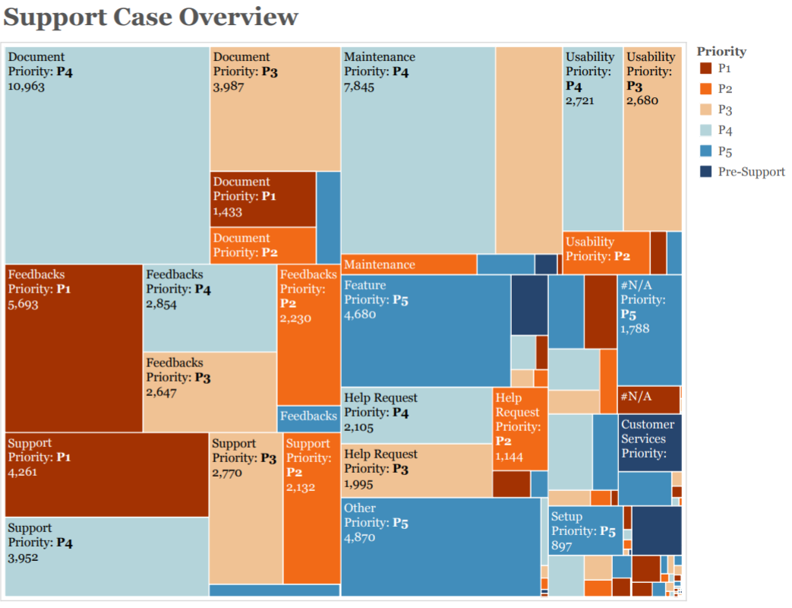
Tree Maps
Looking to see your data at a glance and discover how the different pieces relate to the whole? Then tree maps are for you. These charts use a series of rectangles, nested within other rectangles, to show hierarchical data as a proportion to the whole. As the name of the chart suggests, think of your data as related like a tree: each branch is given a rectangle which represents how much data it comprises. Each rectangle is then sub-divided into smaller rectangles, or sub-branches, again based on its proportion to the whole. Through each rectangle’s size and colour, you can often see patterns across parts of your data, such as whether a particular item is relevant, even across categories. They also make efficient use of space, allowing you to see your entire data set at once.
When to use tree maps:
Showing hierarchical data as a proportion of a whole: Examples: storage usage across computer machines, managing the number and priority of technical support cases, comparing fiscal budgets between years
Also consider:
Colouring the rectangles by a category different from how they are hierarchically structured
Combining tree maps with bar charts. In Tableau, place another dimension on Rows so that each bar in a bar chart is also a tree map. This lets you quickly compare items through the bar’s length, while allowing you to see the proportional relationships within each bar.
This tree map shows all of a company’s support cases, broken by case type, and also priority level. You can see that Document, Feedback, Support and Maintenance make up the lion share of support cases. However, in Feedback and Support, P1 cases make up the most number of cases, whereas most other categories are dominated by relatively mild P4 cases.

Slide 29
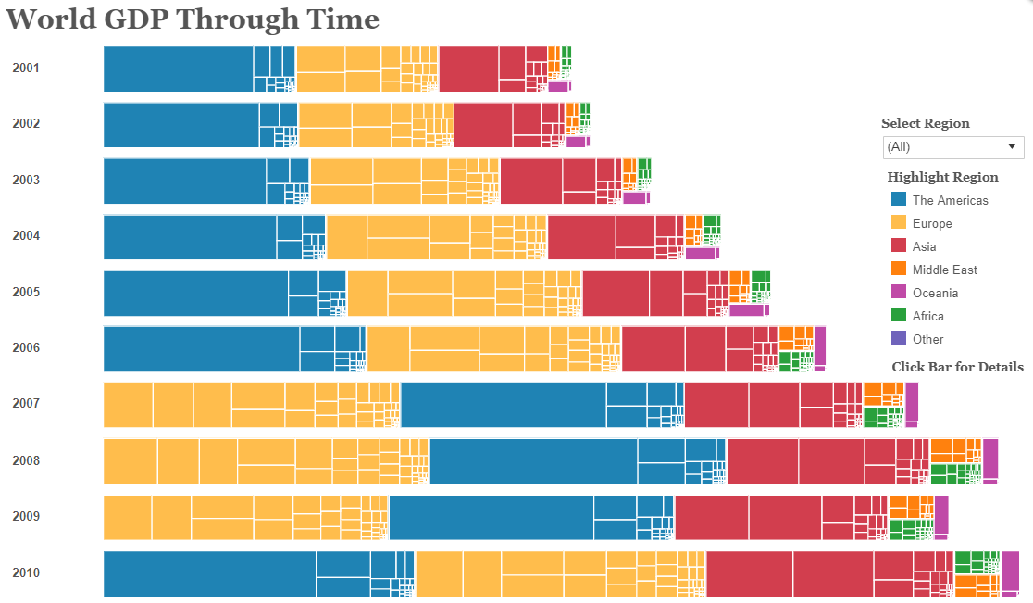
Tree Maps
In this tree map-bar chart combination chart, we can see how overall GDP has grown over time (with the exception of 2009, when GDP fell), but also which regions and countries comprised most of the world’s GDP. Since 2001, the region ‘The Americas’ made up most of the world’s GDP, until 2007 for three years. You can also see that GDP for ‘The Americas’ is made up of largely one rectangle (one country), whereas ‘Europe’ is made up of rectangles that are more similar in size.

Slide 30
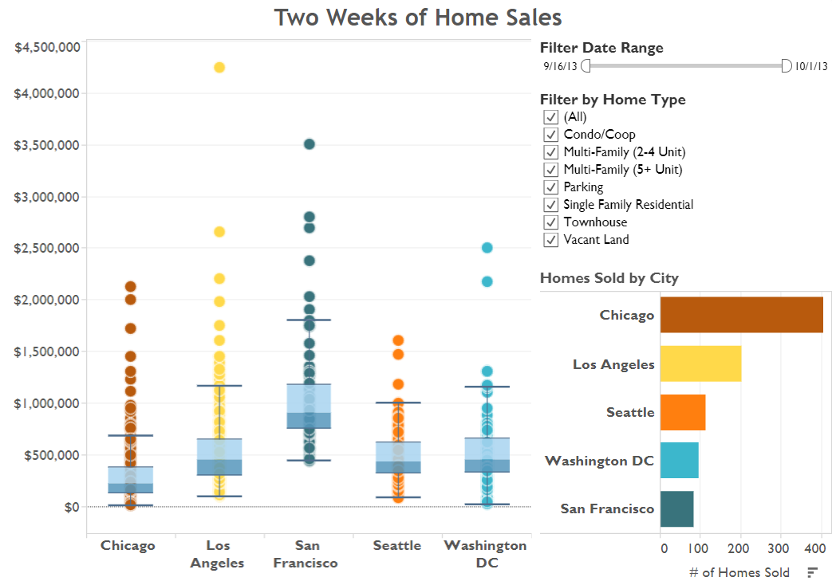
Box and whisker plot
Box-and-whisker plots, or boxplots, are an important way to show distributions of data. The name refers to the two parts of the plot: the box, which contains the median of the data along with the 1st and 3rd quartiles (25% greater and less than the median), and the whiskers, which typically represents data within 1.5 times the Inter-quartile Range (the difference between the 1st and 3rd quartiles). The whiskers can also be used to also show the maximum and minimum points within the data.
When to use box-and-whisker plots:
Showing the distribution of a set of a data: Examples: understanding your data at a glance, seeing how data is skewed towards one end, identifying outliers in your data.
Also consider:
Hiding the points within the box. This helps a viewer focus on the outliers.
Comparing boxplots across categorical dimensions. Boxplots are great at allowing you to quickly compare distributions between data sets.
For this time period, the median prices of homes sold were highest in San Francisco, but the distribution was wider for Los Angeles. In fact, the most expensive home in Los Angeles was sold at several times greater than the median.

Slide 31
Tableau – Performance Tuning

